Slide 1
Module 4: Lesson 3 Spark Concepts

Slide 2
Spark Execution Architecture
Each Spark application runs with its own set of cluster (usually Hadoop) compute and storage resources
The Spark framework uses a controller and worker execution architecture
This consists of a driver (controller) process which runs on the client or a cluster node and many executor (worker) processes which run on worker nodes across the cluster

Slide 3
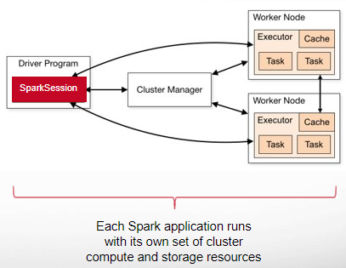
Spark Execution Architecture
Driver Program
Coordinates execution of the Spark app
Executors
Worker processes for executing tasks in Spark app
Cluster Manager
Allocates cluster resources for the Spark app
SparkSession
Entry point to Spark functionality for the app, creates logical and physical plan, and sends tasks to the executors
Tasks
A unit of computation that can be performed on a single partition of data in parallel

Slide 4
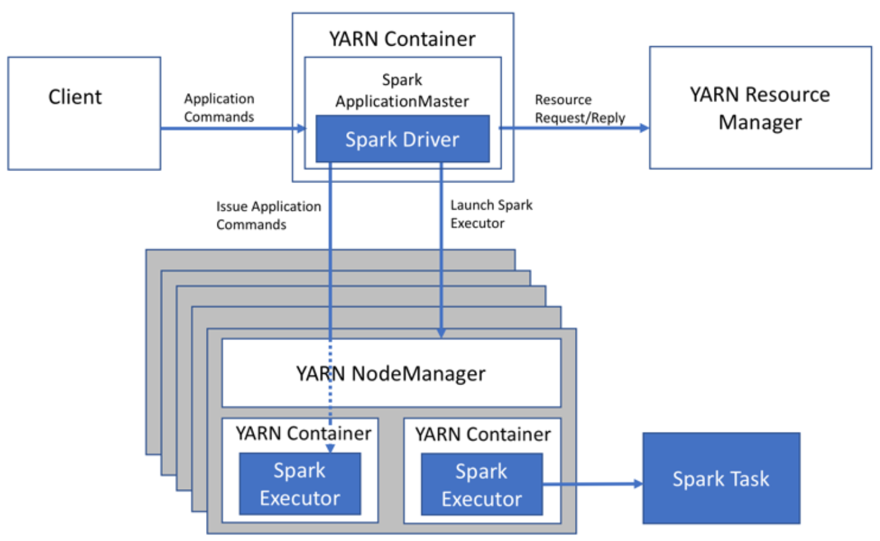
Spark Execution Architecture Cluster Deploy Mode
3
5
1
2
The client (submits a Spark application to YARN
YARN assigns a Spark Master for the application. The driver process is created on the same node
The Spark Master requests containers for executors from YARN. The containers are assigned and the executors are spawned.
The driver then communicates with the executors to execute tasks
The driver returns progress, results, and status to the client
4

Slide 5
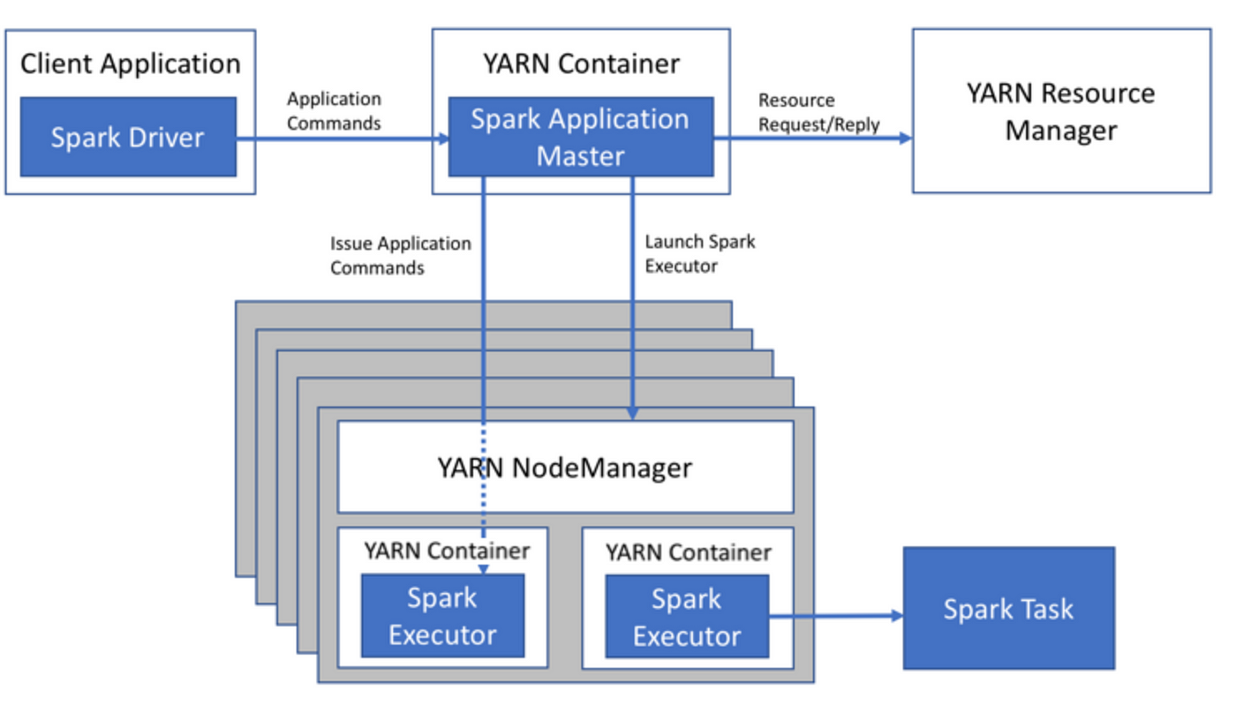
Spark Execution Architecture Client Deploy Mode
1
5
3
2
The client submits a Spark application to YARN. The driver process is created and runs on the client.
YARN assigns Spark master for the application
The Spark master requests containers for executors from YARN. The containers are assigned and the executors are spawned.
The driver (located on the client) then communicates with the executors execute tasks.
The driver returns progress, results, and status to the client.
4

Slide 6
Data Representation
Spark has several core abstractions
Datasets
DataFrames
SQL Views
Resilient Distributed Datasets (RDDs)
These abstractions all represent distributed collections of data however they have different interfaces for working with that data

Slide 7
Resilient Distributed Datasets (RDD) A distributed collection of data organized into a sequence of elements
Spark’s core abstraction for working with data, is the resilient distributed dataset (RDD)
An RDD is simply a distributed collection of elements with no internal structure imposed on them by Spark
Work is expressed as either creating new RDDs, transforming existing RDDs, or calling operations on RDDs to compute a result
Under the hood, Spark automatically distributes the data contained in RDDs across your cluster and parallelizes the operations you perform on them

Slide 8
Resilient Distributed Datasets (RDD)
An RDD in Spark is simply an immutable distributed collection of records (elements)
Each RDD is split into multiple partitions, which may be computed on different nodes of the cluster
RDDs can contain any type of Python, Java, or Scala objects, including user-defined classes

Slide 9
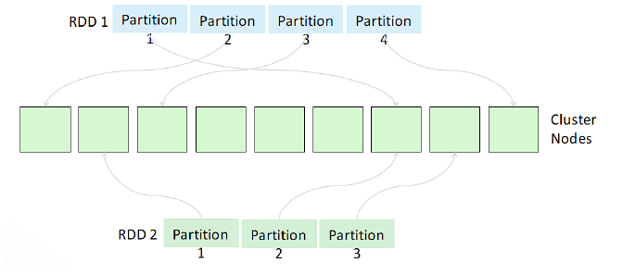
RDD and Partitions
Data Source
load
Data Source
load

Slide 10
Resilient Distributed Datasets (RDD)
As one of the initial intended uses for Spark was to support machine learning, Spark’s RDDs provided a form of shared memory that could make efficient reuse of data for iterative operations
One of the main downsides of Hadoop’s implementation of MapReduce was its persistence of intermediate data to disk and the copying of this data between nodes at runtime
This distributed processing method of sharing data did provide resiliency and fault tolerance but it was at the cost of latency
As data volumes increased along with the necessity for real-time data processing and insights…
Spark’s (mainly) in-memory processing framework based on the RDD has grown in popularity

Slide 11
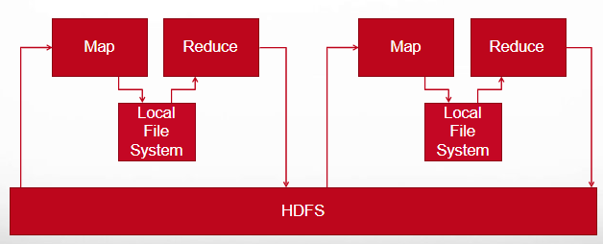
MapReduce File Based Processing

Slide 12
Data Sharing is Slow in MapReduce
The only way to reuse data between two MapReduce jobs is to write it to an external storage system (ex: HDFS, S3, etc.)
So… Data sharing is slow in MapReduce due to overhead of replication, serialization, and disk IO
Most of the Hadoop applications spend more than 90% of the time doing HDFS read-write operations

Slide 13
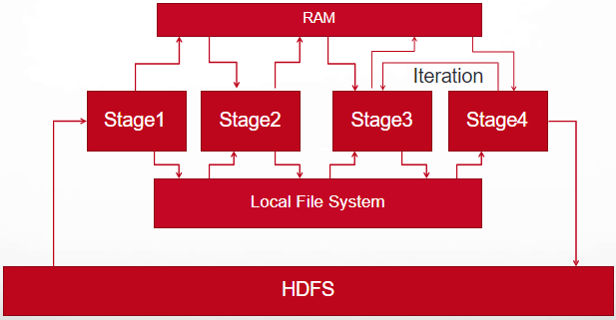
Spark Adaptive (In Memory and File Based Processing)

Slide 14
Data Sharing is Faster in Spark
Spark can store intermediate results in a distributed memory instead of stable storage (HDFS) and make the system faster
Note: If memory is insufficient to store all the intermediate results, then it will store those results on the disk

Slide 15
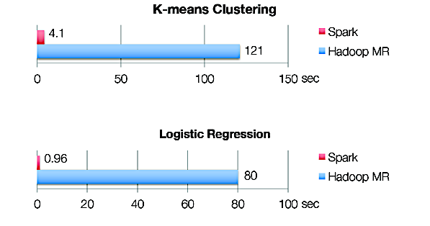
Iterative Algorithms: Spark vs MapReduce

Slide 16
Resilient Distributed Dataset (RDD)
The term Resilient Distributed Dataset is an accurate and succinct descriptor for the concept. Here’s how it breaks down:
Resilient
RDDs are resilient, meaning that if a node performing an operation in Spark is lost, the dataset can be reconstructed
This is because Spark knows the lineage of each RDD, which is the sequence of steps to create the RDD.
Distributed
RDDs are distributed, meaning the data in RDDs is divided into one or more partitions and distributed across worker nodes in the cluster
RDDs provide an effective form of shared memory to exchange data between processes (executors) on different nodes (workers)

Slide 17
Resilient Distributed Dataset (RDD)
RDDs are ordered collections of items that consist of records
Records are uniquely identifiable sequences of data within a dataset
But RDDs do not parse or understand a record’s internal structure
When an RDD is created from a data source Spark does not validate that records of that data source conform to any specific internal format
Rather each RDD record must be parsed and validated as part of a user application
Records could be a collection of fields similar to a row in a table in a relational database, a line of text in a file, or multiple other formats
RDDs are partitioned such that each partition contains a unique set of records and can be operated on independently

Slide 18
Resilient Distributed Datasets (RDD)
Another key property of RDDs is their immutability
After they are instantiated and populated with data, they cannot be updated
Rather, new RDDs are created by performing one or more transformations such as map() or filter() on existing RDDs

Slide 19
Data Locality with RDDs
By default, Spark tries to read data into an RDD from the nodes that are close to it.
As Spark usually accesses distributed partitioned data to optimize transformation operations…
It creates partitions to hold the underlying blocks from HDFS

Slide 20
Resilient Distributed Dataset (RDD)
Because Spark can load data into memory on the worker nodes, many distributed computations can run in a few seconds
This is true even when Spark process terabytes of data across dozens of machines,
This makes the kind of iterative, ad hoc, and exploratory analysis commonly done in shells a good fit for Spark

Slide 21
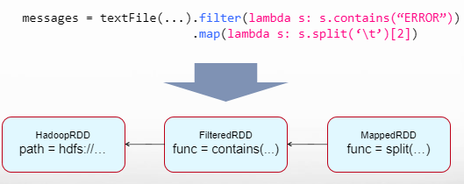
RDD Fault Tolerance
RDDs track the transformations used to build them (their lineage) to recompute lost data
E.g.:
Notes:
Show recomputing

Slide 22
DataFrame
RDDs are part of the Spark core and represent a low-level and direct way of manipulating distributed data using an unstructured format
DataFrames extend RDDs for handling structured data using a table-like representation
It is conceptually equivalent to a table in a relational database with rows (records) having columns (attributes)
Each DataFrame includes a schema defining the names of columns and their data types
It is sometimes useful to think of DataFrames as RDDs augmented with an associated schema
DataFrames inherit their fault tolerance from underlying RDDs, automatically recovering from lost data or other cluster failures, ensuring resilient data processing

Slide 23
DataFrame A distributed collection of data organized into named columns
mpg | horsepower | carname
integer | double | string
20 | 180 | mazda
22 | 170 | ford
40 | 130 | toyota
35 | 135 | jeep
Schema
Logical
Representation
Rows
Columns
Physical
Representation
Partition 1
20 | 180 | mazda
22 | 170 | ford
Partition 2
40 | 130 | toyota
35 | 135 | jeep

Slide 24
DataFrames
DataFrames can be constructed from data sources, such as CSV, Parquet, JSON files, Hive tables, or external databases
DataFrames offers a user-friendly, high-level API that supports operations for querying, filtering, and grouping data, simplifying data manipulation
SQL-like syntax simplifies data transformations for users familiar with relational databases
Spark employs a query optimizer called Catalyst to analyze DataFrame operations and generate efficient execution plans
Catalyst's optimizations often lead to faster execution compared to direct RDD manipulation
Code you write using the DataFrame API gets translated to a series of Spark Core (RDD) transformations under the hood.
DataFrames seamlessly integrate with other Spark functionality fostering a cohesive data analysis experience.

Slide 25
DataFrame
Spark is able to infer a schema by making a pass over the entire dataset that’s being loaded
When calculating the execution plan, Spark can use the schema and do better computation optimizations
Alternatively you can programmatically associate a schema with a DataFrame

Slide 26
DataFrame API
DataFrames can be constructed from a wide range of sources including…
An existing RDD
A JSON file
A text file, Parquet file, or ORC file
A table in Hive
An external database

Slide 27
DataFrame API
As an example, the following creates a DataFrame based on the content of a JSON file:
df = spark.read.json(”hdfs://examples/src/main/resources/people.json")
# Displays the content of the DataFrame to stdout
df.show()

Slide 28
DataFrame API
DataFrames translate SQL code and domain-specific language (DSL) expressions into optimized low-level RDD operations…
The same API can be used
from any supported language (Scala, Java, Python, and R)
for accessing any supported data source (files, databases, and so forth)
in the same way and with comparable performance characteristics

Slide 29
DataFrame Performance
DataFrames can be significantly faster than RDDs
And they perform the same, regardless of language

Slide 30
Datasets
Within the Structured APIs, there are the “untyped” DataFrames and the “typed” Datasets
A Dataset is a strongly typed collection of domain-specific objects that can be transformed in parallel using functional or relational operations.
To say that DataFrames are untyped, however, is slightly inaccurate; they have types (as specified by their associated schemas)
But Spark maintains this completely at the framework level and only checks whether those types line up to those specified in the schema at runtime
Datasets, on the other hand, check whether types conform to the specification at compile time
Datasets are only available to Java Virtual Machine (JVM)–based languages (Scala and Java)

Slide 31
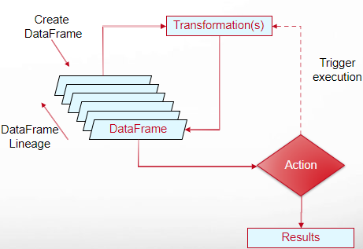
Transformations and Actions
Operations available on DataFrames (Datasets) are divided into transformations and actions
Transformations are the ones that produce new DataFrames (Datasets)
Actions are the ones that trigger computation and return results

Slide 32
Transformations
Transformations form the cornerstone of Spark workflows
They allow you to manipulate RDDs, DataFrames, or Datasets without triggering immediate computation.
They (when triggered) create new RDDs, DataFrames, or Datasets based on existing ones, enabling chained operations for complex data exploration and analysis.
Each transformation returns a new RDD, DataFrame, or Dataset leaving the original untouched.
This immutability promotes data consistency and simplifies lineage tracking for error handling and fault tolerance.

Slide 33
Transformations
Spark offers a rich selection of built-in transformations for filtering, aggregating, joining, sorting, and modifying data
Transformations can be chained together to create intricate data processing workflows
targetDF= srcDF.transform1(…).transform2()
Each successive operation builds upon the previous one, allowing you to extract granular insights or prepare data for further analysis.
Spark automatically optimizes transformation chains

Slide 34
Transformations
In Spark the core data structures are immutable, meaning they cannot be changed once created.
This might seem like a strange concept at first: If you cannot change it how are you supposed to work with data
In order to “change” a DataFrame, you have to instruct Spark to construct the DataFrame you want from the one you have

Slide 35
Transformations
Transformations construct a new DataFrames (or RDDs) from a previous one.
For example, one common transformation is filtering data that matches a predicate
In our example, we use this to create a new DataFrame with records having miles-per-gallon > 25
targetDF = srcDF.filter(col(‘mpg’) > 25)
Target DataFrame holding records about cars having mileage > 25
Source DataFrame holding records
about cars and the mileage they get

Slide 36
Actions
Unlike transformations that create new DataFrames without immediate execution, actions trigger Spark to process the data and deliver a final result
Actions generate concrete outputs, such as counts, aggregated statistics, or collected data elements, unlike transformations that produce intermediate DataFrames.
Actions force the DataFrame to materialize and compute all partitions, making the final result available for external interactions or further analysis.

Slide 37
Actions
Transformations within the action chain are only evaluated when necessary for computing the final result, optimizing resource utilization.
Actions initiate communication with executors on worker nodes to execute tasks and collect the final result back to the driver program.
Spark offers a diverse range of actions, including count(), collect(), first(), foreach(), and write(), catering to various data analysis and workflow needs.

Slide 38
Actions
There are three kinds of action
Actions to view data in the console
Actions to collect data to native objects in Scala, Java or Python
Actions to write the content of DataFrames (or RDDs) to files, object, records in a database, etc.

Slide 39
Lazy Evaluation
Transformations is Spark are lazy, which means they do not produce a result immediately when they first execute
Rather when a transformation is first executed it records its intent to construct a new DataFrame (or RDD) to a logical execution plan
Spark internally represents the logical execution plan as a lineage graph, which is a workflow of transformations to be performed
Actions, another type of operation, are what actually trigger the execution of the logical execution plan
This is part of what allows Spark to be robust to failures, by being able to reconstruct an RDD or DataFrame by following its lineage

Slide 40
Lazy Evaluation
A benefit of creating a logical execution plan is that the plan can be evaluated in its entirety and optimized for performance
This is the role of another critical element of Spark, the Catalyst optimizer

Slide 41
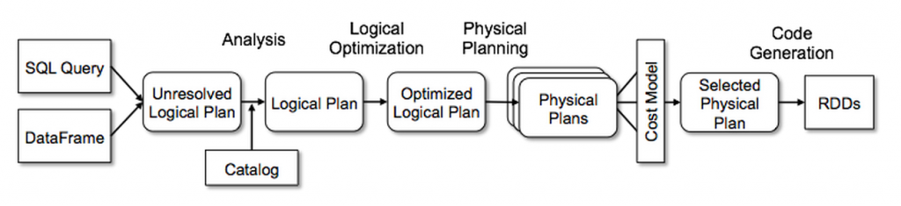
Catalyst Optimizer
Upon encountering an action Spark converts transformations or code to a Logical Plan
Spark then transforms this Logical Plan to a Physical Plan, introducing optimizations along the way
Spark then executes this Physical Plan as tasks on the cluster

Slide 42
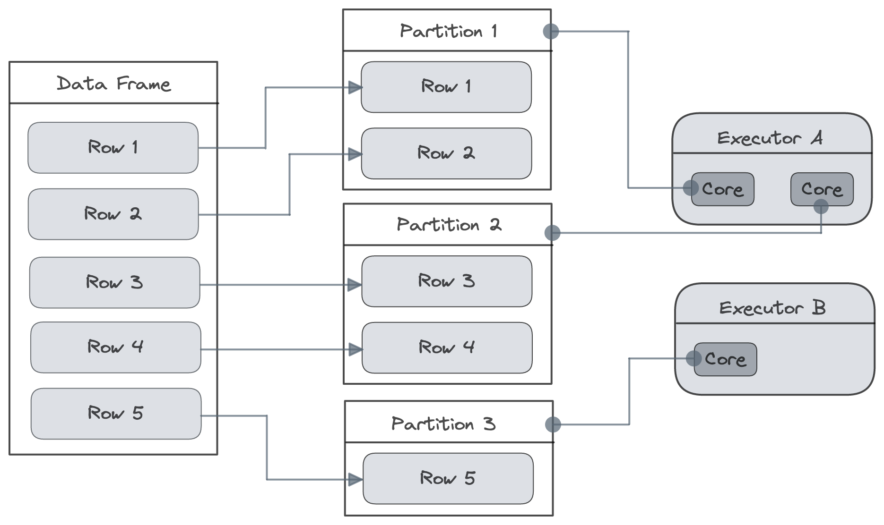
Partitions
In order to allow every executor to perform work in parallel, Spark breaks up the data into chunks, called partitions
A partition is a collection of DataFrame or Dataset rows that sit on one physical (or virtual) machine in our cluster
A DataFrame’s partitions represent how the data is distributed across a cluster of machines during execution
If you have one partition, Spark will only have a parallelism of one even if you have thousands of executors.
If you have many partitions, but only one executor Spark will still only have a parallelism of one because there is only one computation resource

Slide 43
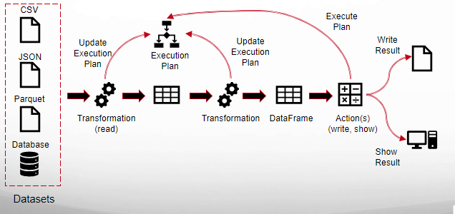
An End to End Example
This shows the general flow of a Spark application:
read → dataframe →((transform → dataframe) _{repeat} → action → result)_{repeat}

Slide 44
An End to End Example
Here will will work an example step by step using some car data
The data source holding the car data is a file in CSV format with a header row
The name of this file is “/Users/nachdaph/auto-mpg.csv”
+----+---------+----------+---------+------------------+
| mpg|cylinders|horsepower|modelyear| carname|
+----+---------+----------+---------+------------------+
|18.0| 6| 88.0| 71| ford mustang|
|18.0| 6| 105.0| 73| plymouth valiant|
|15.0| 8| 150.0| 73| dodge dart custom|
|23.5| 6| 110.0| 81|chevrolet citation|
|37.7| 4| 62.0| 81| toyota tercel|
|38.0| 4| 67.0| 82| datsun 310 gx|
+----+---------+----------+---------+------------------+

Slide 45
An End to End Example
We first create a SparkSession instance and assign it to the variable ‘spark’
This is our Spark driver which will control execution of our Spark program
The master() method specifies we will execute our program locally, using one CPU core, which is useful for debugging
In order to read this data in, we will use a DataFrameReader that is associated with our SparkSession
In doing so, we will specify the file format as well as other options
In our case, we want Spark to infer the schema (column types) by inspecting the data file
We also want to specify that the first row is the header in the file, we’ll specify that as an option too.
import pyspark
from pyspark.sql import SparkSession
from pyspark.sql.functions import col
spark = SparkSession.master('local[1]').appName(‘demo').getOrCreate()
df = spark.read.format("csv")\
.option("header", 'true’)\
.option("inferSchema", True)\
.load("/Users/nachdaph/auto-mpg.csv")

Slide 46
An End to End Example
Each of these DataFrames have a set of columns with an unspecified number of rows
The reason the number of rows is “unspecified” is because reading data is a transformation, and is therefore a lazy operation
If we perform the head() action on the DataFrame, first the file will be read and then the results are output
df.head()
Row(mpg=18.0, cylinders=6, horsepower=88.0, modelyear=71, carname='ford mustang')

Slide 47
An End to End Example
Let’s define some more transformations!
Now we will filter our data according to the ‘mpg’ column which is a double type
Nothing happens to the data when we call filter because it’s just a transformation
However, Spark is building up an execution plan for how it will execute this across the cluster
df2 = df.filter(df['mpg'] < 25)

Slide 48
An End to End Example
Let’s cause our filter transformation to execute by applying an action to the DataFrame df2
Our action will display the DataFrame content
df2.show()
+----+---------+----------+---------+------------------+
| mpg|cylinders|horsepower|modelyear| carname|
+----+---------+----------+---------+------------------+
|18.0| 6| 88.0| 71| ford mustang|
|18.0| 6| 105.0| 73| plymouth valiant|
|15.0| 8| 150.0| 73| dodge dart custom|
|23.5| 6| 110.0| 81|chevrolet citation|
+----+---------+----------+---------+------------------+

